Slide 1
Alternative Mining Puzzles

Slide 2
Puzzles are the core of Bitcoin
Incentive system steers participants
Basic features of Bitcoin’s puzzle (recap)
The puzzle is difficult to solve, so attacks are costly
… but not too hard, so honest miners are compensated
What other features could a puzzle have?
Notes:
Recap to earlier lectures?

Slide 3
Alternative puzzle designs
Used in practice, and speculative
Variety of possible goals
ASIC resistance, pool resistance, intrinsic benefits...
Essential security requirements

Slide 4
Essential Puzzle Requirements

Slide 5
ASIC-Resistant Puzzles
a. Motivation:
ASICs dominate mining due to their efficiency.
Level the field so general-purpose computers can participate.
b. Memory-Hard Puzzles
Require significant RAM rather than just CPU.
Memory-bound: Time to access memory dominates compute time.
c. Scrypt
Used in Litecoin.
Originally a password-hashing function.
Two Steps:
Fill a buffer with pseudorandom data.
Access it in pseudorandom order.

Slide 6
Memory-use makes recomputing expensive (O(N^2) if no buffer).
Tradeoffs exist between time and memory.
d. Limitations:
Verification is also memory-intensive.
Litecoin used low memory values (128KB), making ASICs feasible.
e. Other ASIC-Resistance Approaches
X11 (used in DASH): Combines 11 hash functions.
Cuckoo Cycle: Graph-based, memory-hard but easier to verify.

Slide 7
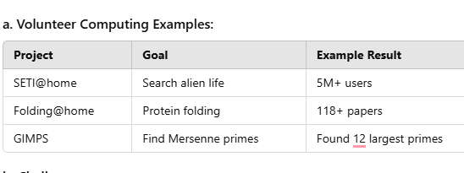
Proof-of-Useful-Work
Use mining power for socially beneficial tasks

Slide 8
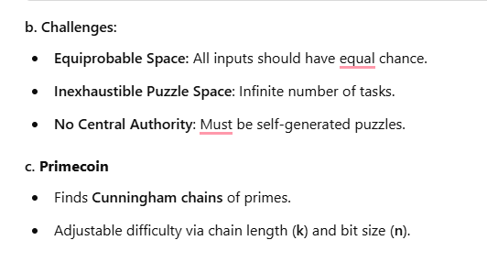
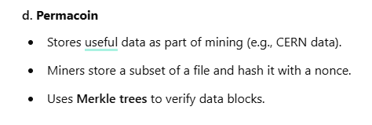

Slide 9
Puzzle requirements
- Cheap to Verify
- Adjustable difficulty
…
- Chance of winning is proportional to hashpower
- Large players get only proportional advantage
- Even small players get proportional compensation

Slide 10

Bad puzzle: a sequential puzzle
Consider a puzzle that takes N steps to solve
a “Sequential” Proof of Work
N
Solution Found!

Slide 11

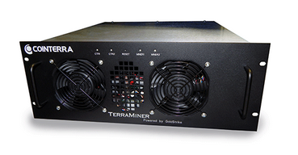
Bad puzzle: a sequential puzzle
Problem: fastest miner always wins the race!
Solution Found!
Notes:
Clipart: from tango project, public domain

Slide 12
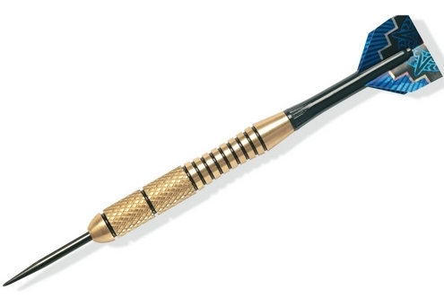
Good puzzle → Weighted sample
This property is sometimes called “progress-free”
Notes:
Dart image from wikipedia

Slide 13
ASIC Resistant Puzzles

Slide 14
ASIC resistance - Why? (1 of 2)
Goal: Ordinary people with idle laptops, PCs, or even mobile phones can mine!
Lower barrier to entry
Approach: reduce the gap between custom hardware and general purpose equipment

Slide 15
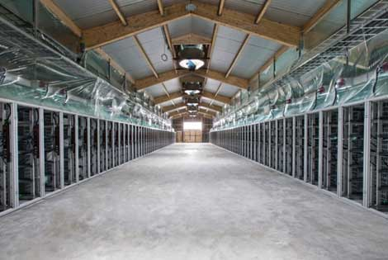
ASIC resistance - Why? (2 of 2)
Goal: Prevent large manufacturers from dominating the game
“Burn-in” advantage
In-house designs
Approach: reduce the “gap” between future hardware and the custom ASICs we already have
Notes:
Image taken from lecture 5

Slide 16
Memory hard puzzles
Premise: the cost and performance of memory is more stable than for processors
10000
Processors
1000
“performance gap”
Memory
Performance
100
Storage
10
‘80 ‘90 ‘00 ‘10 ‘14
Time

Slide 17
Proof-of-useful-work

Slide 18
Recovering wasted work
Recall:
between 150 MW - 900 MW power consumed
Natural question:
Can we recycle this and do something useful?
(as of mid-2014)

Slide 19
Candidates - needle in a haystack
Natural choices:
- Protein folding (find a low energy configuration)
- Search for aliens (find an anomalous region of a signal)
These have been successful @Home problems
Challenges:
- Randomly chosen instances must be hard
Who chooses the problem?

Slide 20
Large mining pools are a threat
Bitcoin’s core value is decentralization
If power is consolidated in a few large pools, the operators are targets for coercion/hacking
Position: large pools should be discouraged!
Analogy to voting: It’s illegal (in US) to sell your vote

Slide 21
Proof-of-Stake
“Virtual Mining”

Slide 22


Mining has an unnecessary step
Proof-of-Work Mining:
Earn mining rewards
Spend money on power and equipment
Miner
Find puzzle solutions
Notes:
Factory image from wikipedia
Miner image from Lecture 4

Slide 23
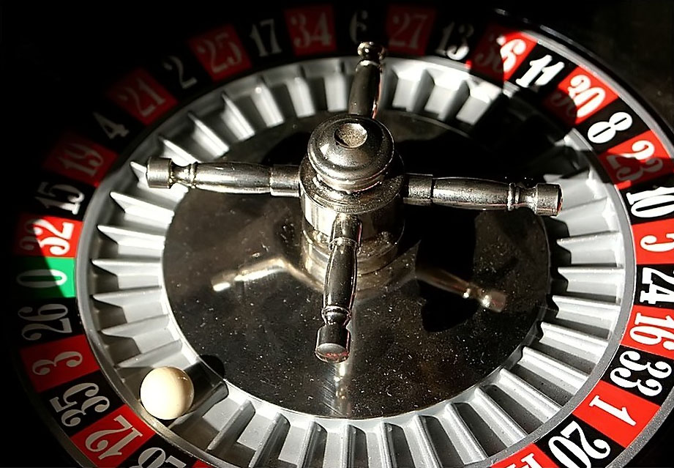
Mining has an unnecessary step
Virtual Mining:
Earn mining rewards
Miner
Winners chosen at random by lottery
“Mine” by sending money to a special address

Slide 24
Potential benefits
Lower overall costs
- No harm to the environment
- Savings distributed to all coin holders
Stakeholder incentives - good stewards?
No ASIC advantage
51% attack is even harder

Slide 25


51% attack prevention
The Bitcoin economy is smaller than the world
Wealth outside Bitcoin has to move inside
Bitcoin Economy
Wealthy Attacker
Bitcoin Economy
Wealthy Attacker
Exchange
Attack
Attack
Notes:
Money and Capitol icons public domain from pixabay

Slide 26
Variations of Virtual Mining
Proof-of-Stake: “Stake” of a coin grows over time
as long as the coin is unused
Proof-of-Burn: mining with a coin destroys it
Proof-of-Deposit: can reclaim a coin after some time
Proof-of-Activity: any coin might be win (if online)

Slide 27
Conclusion
Many possible design goals
Prevent ASIC miners from dominating
Prevent large pools from dominating
Intrinsic usefulness
Eliminate the need for mining hardware at all
Best tradeoff is unclear for now
Outlook: alternatives will coexist for the near future

Slide 28
Bitcoin as a Platform
Applications beyond just currency:
Lotteries
Prediction markets
Smart contracts
Randomness
Smart properties
… and more

Slide 29
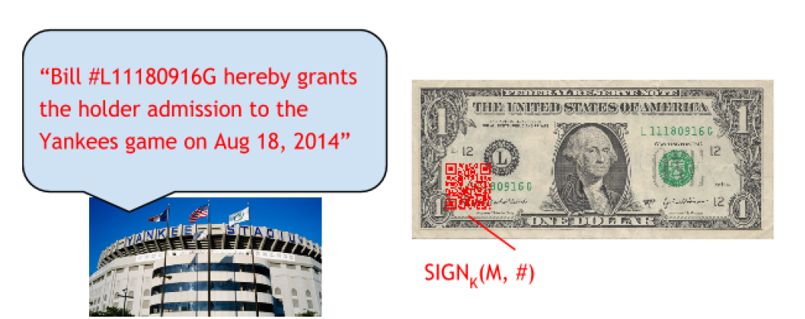
Bitcoin as Smart property

Slide 30
Bitcoin as Smart property
Bitcoin as smart property revolves around using its decentralized, secure nature to represent and transfer ownership of digital or physical assets in an automated, trustless way.
Characteristics:
Ownership Verification
Decentralized Control
Automation of Transfers
Tokenization
Security and Trustlessness
As smart property, Bitcoin offers a secure, trustless way to manage ownership. Blockchain's immutability ensures that once an ownership transfer occurs, it cannot be reversed or tampered with. This makes Bitcoin ideal for creating tamper-resistant systems for transferring or controlling assets.
This makes Bitcoin ideal for creating tamper-resistant systems for transferring or controlling assets.

Slide 31
For example, imagine buying a car using Bitcoin. Instead of relying on a dealer or a bank to handle the payment and transfer the car’s ownership, a smart contract can automate the whole process. Here’s how it works:
1.Smart Contract Setup: The seller of the car creates a smart contract that specifies the conditions for transferring ownership. This might include receiving a specific amount of Bitcoin.
2.Payment with Bitcoin: The buyer sends the agreed amount of Bitcoin to the smart contract. This is recorded securely on the blockchai
3.Automatic Transfer: Once the smart contract confirms that the payment has been made, it automatically transfers ownership of the car to the buyer. This can be done by changing the car's digital title, unlocking digital keys, or updating a blockchain-based registry.
4.Transparency and Security: The transaction is transparent because all actions are recorded on the blockchain, and it’s secure because the process cannot be tampered with. Once the conditions are met, the contract automatically completes the transaction.

Slide 32
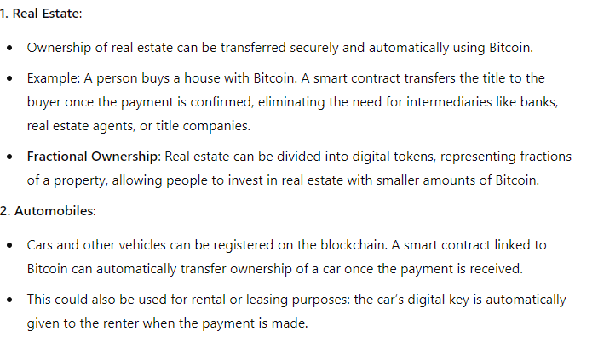
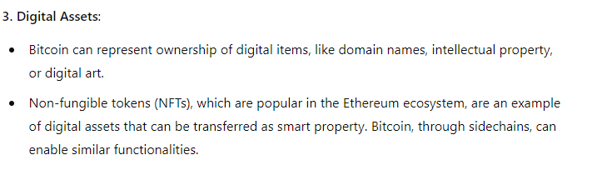
Applications of Bitcoin as Smart Property:

Slide 33
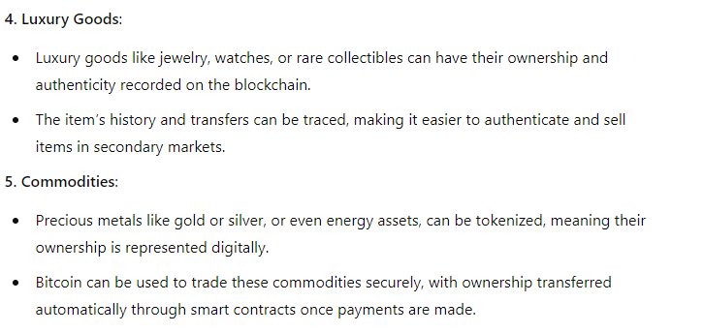

Slide 34
Crowdfunding and Fundraising
Gambling and Prediction Markets….

Slide 35
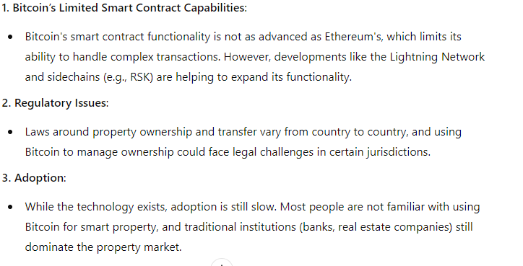
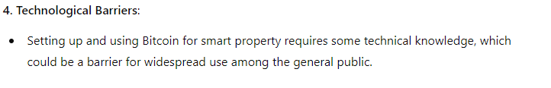
Challenges and Limitations

Slide 36
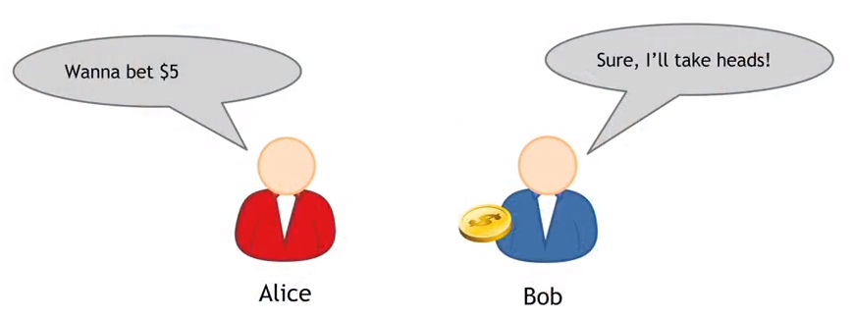
Secure Multi-Party Lotteries in Bitcoin;
Multi-Party Lotteries offline version

Slide 37
Multi-Party Lotteries online version
The better idea is to use an hash commitment. Publishing H(x) is a commitment to x, in fact:
it's not possible to find later some x'≠x such that H(x)=H(x')
H(x) reveals no information about x, assuming that the space of the possible outcomes is big.

Slide 38
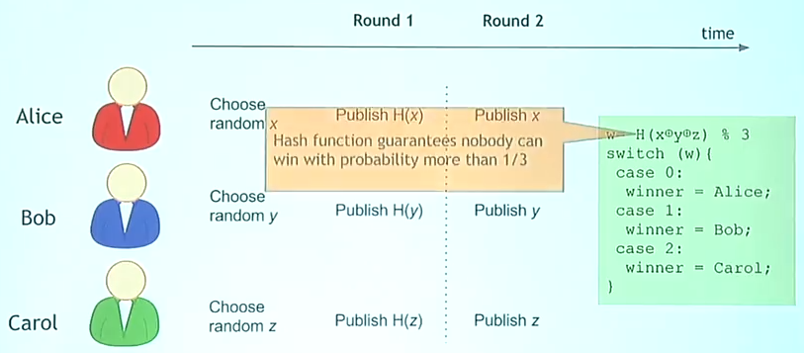
Use hash commitment for online lotteries(A lottery with hash commitments)
1. each of them chooses a random number called nonce. Ant they will keep it secret
2.. Round 1: each participant will publish an hash commitment of their random data. Of course they will have to choose the number from a space that it's wide enough, so that the hash doesn't reveal information about the value.
3. Round 2: this phase has to happen strictly after the round 1 is finished. Each participant publish the random number they chose.
4. Determine the winner: we can use any simple algorithm to compute the winner. For example an algorithm that compute the hash of the three random numbers xor and takes its module divided by three. Now if we assigned a number from 0 to 2 to each participant we will have a winner and the properties of hash function guarantees us that the outcome is fair.

Slide 39
What happens if a user refuses to publish its random number?
Suppose that in Round 2, Carol sees the random numbers published by Alice and Bob, understands that she's going to lose and just goes offline.
Without all the outcomes it's impossible to run the final algorithm and find out the winner. By itself the protocol doesn't protect participants from malicious users.

Slide 40
Use timed hash commitment for online lotteries
To prevent users to be malicious is to force the commitment within a time t.
For example, if Alice is trying to enter into a times hash commitment with Bob, she will put up a bond and make transaction that will pay the bond in two cases:
Alice and Bob both sign (multisignature)
Alice signs and reveals what her data was. In this case, it is possible to check there's a value x in redemption script that have the hash she committed (pay-to-hash-script)

Slide 41
Timed hash commitment lottery pros and cons
Pros:
This process can be implemented on top of Bitcoin infrastructure today, without any change to Bitcoin scripts
Cons:
The algorithm is quite complicates, since it requires multiple transactions. When there are N players, the complexity will be O(N²)
The key property to guarantee fairness is that the bond must be higher than the bet. So, it's not the most efficient way to make lotteries, since players need to have a higher amount of money to put at stake.

Slide 42
Secure Multi-Party Lotteries in Bitcoin;
Multi-Party Lotteries offline version

Slide 43
Multi-Party Lotteries online version
how to generate randomness that both parties can agree is fair
how to force the party who loses to pay
So, a better idea is to use an hash commitment. Publishing H(x) is a commitment to x, in fact:
it's not possible to find later some x'≠x such that H(x)=H(x')
H(x) reveals no information about x, assuming that the space of the possible outcomes is big

Slide 44
Use hash commitment for online lotteries(A lottery with hash commitments)
1. each of them chooses a random number called nonce. Ant they will keep it secret
2.. Round 1: each participant will publish an hash commitment of their random data. Of course they will have to choose the number from a space that it's wide enough, so that the hash doesn't reveal information about the value.
3. Round 2: this phase has to happen strictly after the round 1 is finished. Each participant publish the random number they chose.
4. Determine the winner: we can use any simple algorithm to compute the winner. For example an algorithm that compute the hash of the three random numbers xor and takes its module divided by three. Now if we assigned a number from 0 to 2 to each participant we will have a winner and the properties of hash function guarantees us that the outcome is fair.

Slide 45
What happens if a user refuses to publish its random number?
Suppose that in Round 2, Carol sees the random numbers published by Alice and Bob, understands that she's going to lose and just goes offline.
Without all the outcomes it's impossible to run the final algorithm and find out the winner. By itself the protocol doesn't protect participants from malicious users.

Slide 46
Working with Data Frames
Create a data frame with three columns: Name, Age, and Score.
Add a new column Grade based on the Score:
Grade = "A" if Score > 80.
Grade = "B" if Score > 60 & Score <= 80.
Grade = "C" otherwise.
Sort the data frame by the Score column in descending order.
3. Data Import and Export
Import a CSV file into R (use any dataset or create your own).
Display the first 10 rows and summary statistics of the dataset.
Save the dataset as a new CSV file after performing some transformations.

Slide 47
Create a data frame with three columns: Name, Age, and Score.
Add a new column Grade based on the Score:
Grade = "A" if Score > 80.
Grade = "B" if Score > 60 & Score <= 80.
Grade = "C" otherwise.
Sort the data frame by the Score column in descending order.
2

Slide 48
Create a small data frame (e.g., student names, marks, and grades).
Perform the following operations:
Filter rows where marks are greater than 50.
Add a new column "Pass/Fail" based on marks.
Calculate the average marks of all students.
Replace missing values in the data frame with the mean value (manually create a missing value for practice).

